Slide 1
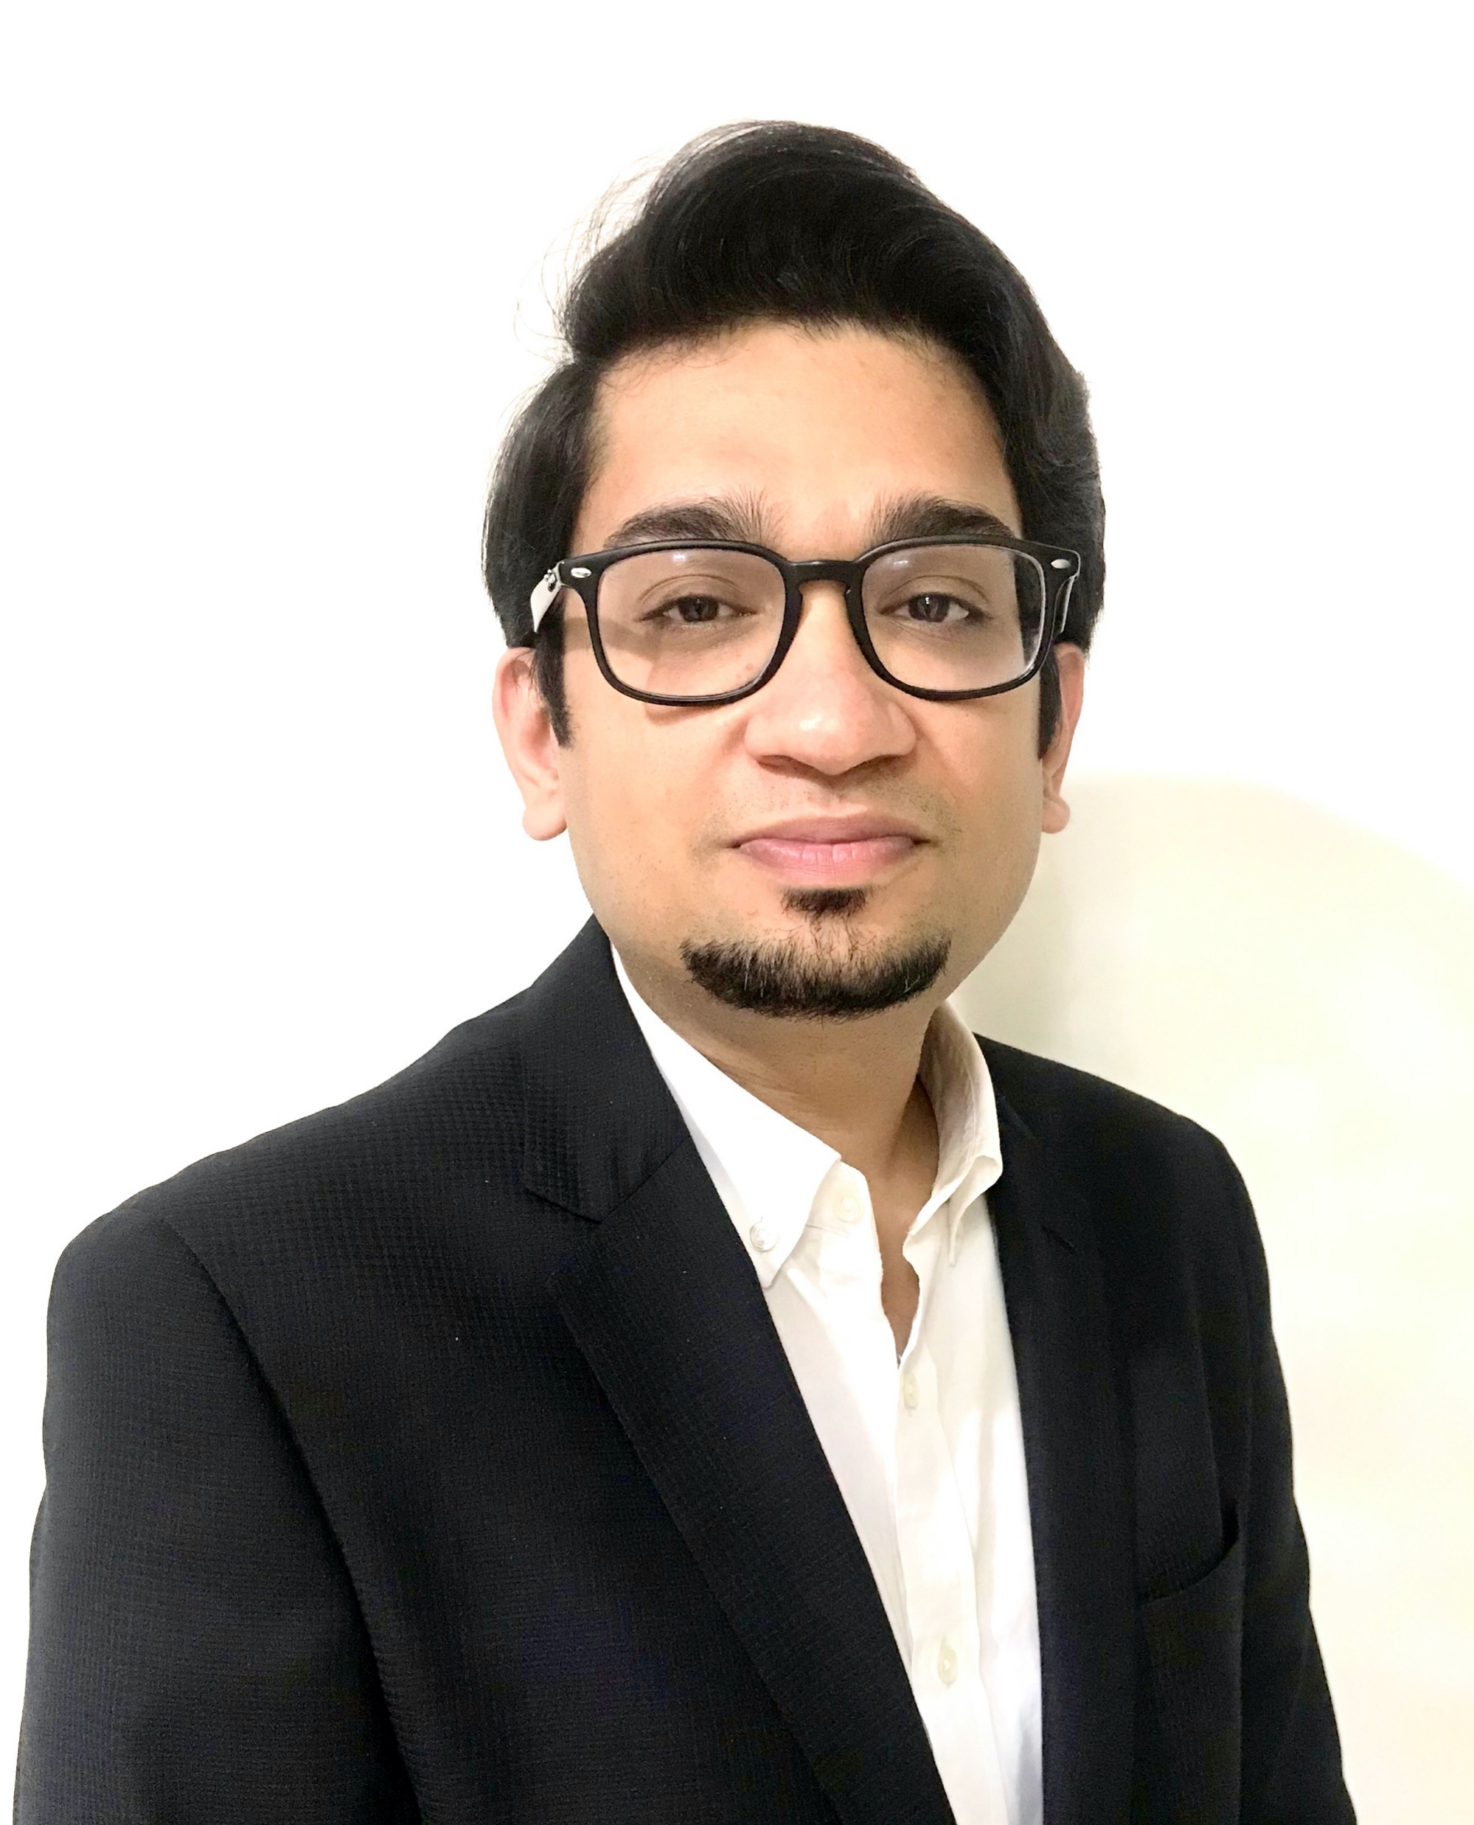
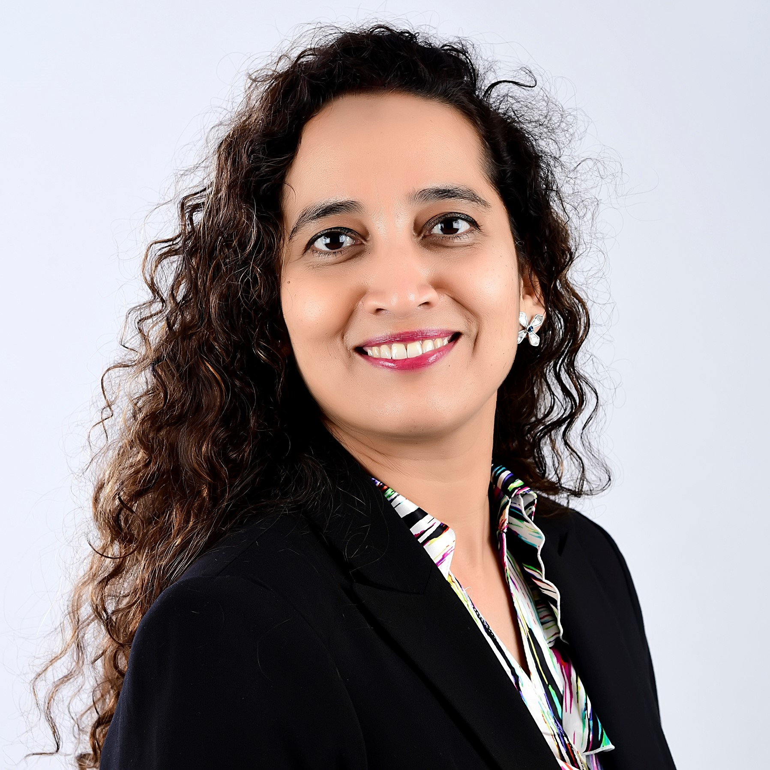
Profile
Pranav Kaushik
Partner, dGTL
E: pranav.k@in.gt.com
  Professional background
  Pranav is a seasoned management consultant with over 15 years of experience in Intelligent Automation, Shared Services and Outsourcing Advisory, Financial Management Advisory, and Product Development. He currently leads Digital Transformation services at dGTL. He has worked across Consumer Markets, Telecom, Technology, and Industrial Manufacturing clients. He has extensive knowledge of automating Finance and Accounting, Supply Chain, HR, IT and Tax processes.
  Pranav has led and managed large scale Finance Transformation program for a UK based Retailer. The engagement entailed assessing ~1000 FTE Finance Shared Service Center to redefine the operating model and use automation technologies to deliver highly efficient and Effective operations. Identified 150+ process improvement and automation opportunities in areas of PTP, RTR, OTC, MDM that resulted in 70% bandwidth reduction.
  Pranav has led and managed a large-scale Intelligent Automation Program for an Indian Conglomerate. The program entailed working across the automation life-cycle – Opportunity Assessment across Finance (PTP, RTR, OTC), HR, and Procurement function, Automation Tool Selection (UiPath), Roadmap and Business case development, Automation COE design and Setup, Implementation, and Support.

