Slide 1
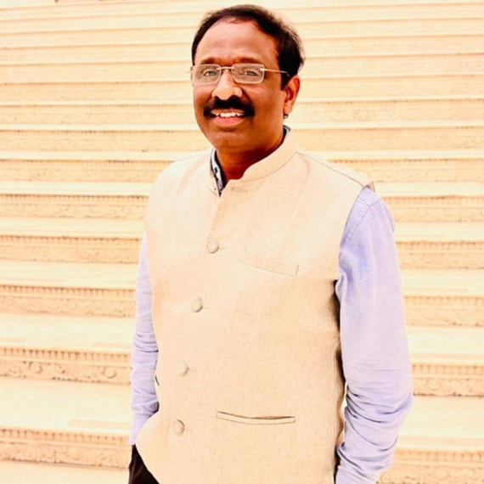
Profile
A Senior Leader in IT industry with 28+ years of diversified global experience in Product engineering, Strategic and operational management, scaling high performing organizations, maximizing revenue & growth through client satisfaction and disciplined leadership.
Currently working as Chief Technology Officer (CTO) in Aravind Eye Care System, world’s largest eye Hospital with 20,000 – 22,000 patients’ footprints in a day at 125 facilities in India and supporting over 150 plus eye hospitals across the world.
Proven record of leading $200 million budgeted strategic projects and managed global teams’ peak size of 600+ high-performance engineers covering domains of Healthcare, Banking, Insurance, Retail, Telecom, and Automotive clients.
12 years plus with IBM -Tokyo responsible for Portable Products Assurance – worldwide releases.
Instrumental to setup various IT ventures in his career which includes AUROiTECH Digital Solutions Foundation under Aravind Eye Care System focusing only Healthcare needs, IBM product assurance labs in Singapore and Kuala Lumpur, Center of Excellence for Products assurance in Exela Technologies.
18 years of vast experience in Onsite engagements (covering North America and South East Asia) directly working with strategic fortune 500 clients.
Active contributor in sharing the IT best practices and solutions in the community forums such as CIO Club, CISO platforms, Healthcare and Technology forums.
Srinivasulu Thayam
CTO - Aravind Eye Care System

