Slide 1


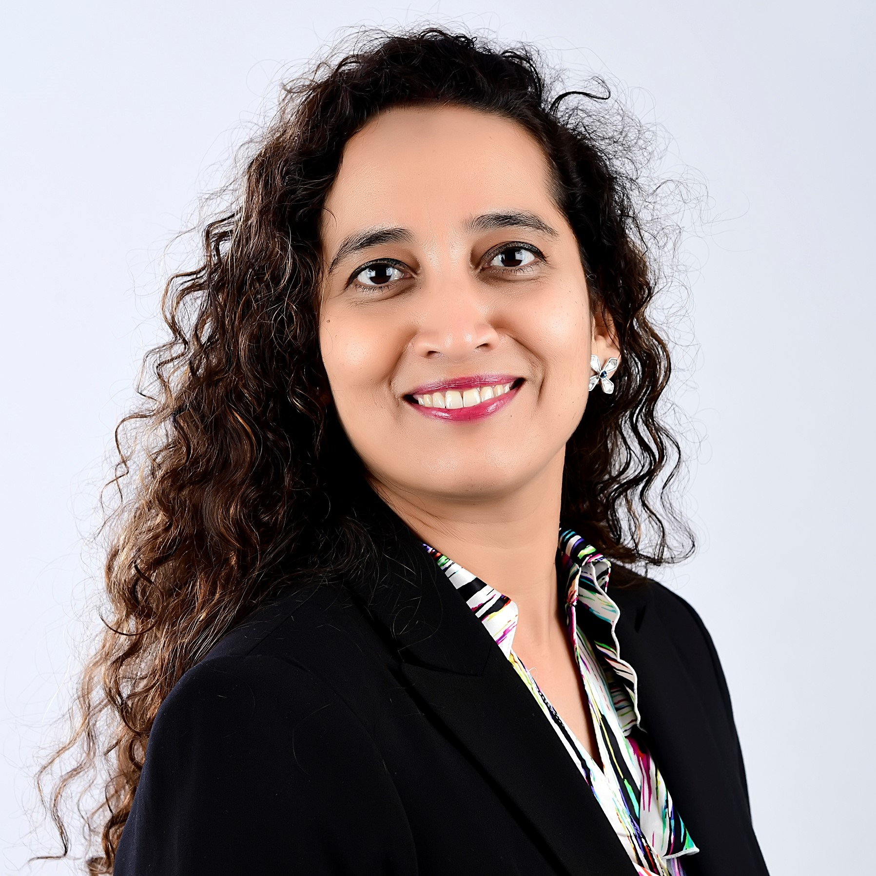
Speaker Profile
Suresh Venkatesan is a Partner, Technology consulting practice with Grant Thornton (GT) in India. Over the past three decades he has spent time in the Banking and Financial services industry both with leading financial institutions and technology consulting service providers.
He has worked across business, technology, consulting, and operations in different geographies. Given his unique blend of experience working with large organizations, impact institutions and startups, he adopts a holistic view while addressing the client needs. Suresh has set up three global technology, operations and analytics practice for Fortune 500 companies.
During the pandemic he has built an end-to-end loan life cycle management solution with minimal human interventions to facilitate working capital and funding requirements for farmers and agri enterprises. This timely intervention has helped 1500+ Farmer collectives to support ~million rural population in continuing their livelihood activities. He considers this to be a key accomplishment in his professional career.
Beyond work, he is actively involved in agriculture, as a volunteer with The Agri Collaboratory and in promoting Heartfulness wellness practice.
© 2024 Grant Thornton Bharat LLP. All rights reserved.
Page | 4 © 2024 Grant Thornton Bharat LLP. All rights reserved.

